Slide 1
ECE131: BASIC ELECTRICAL AND ELECTRONICS ENGINEERING
UNIT 1: DC CIRCUITS
Lecture 1 and Lecture 2
Prepared By: Asha Rani

Slide 2
UNIT-1 Fundamentals of D.C. circuits
✓Work, Power, Energy
✓Ohm’s Law
✓Resistance(Series and Parallel)
✓Inductor (Series and Parallel)
✓Capacitor (Series and Parallel)

Slide 3
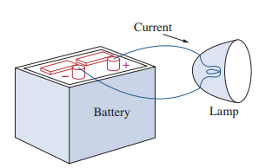
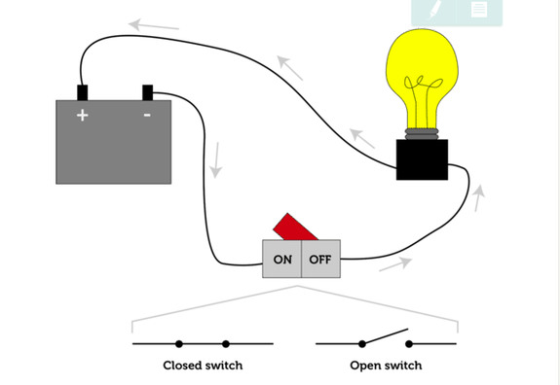
Electrical Circuit

Slide 4

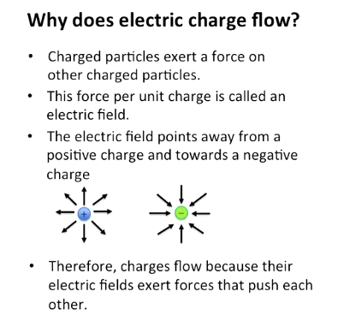
Charge and Current
Charge: Charge is an electrical property of the atomic particles of a matter.
S.I Unit: Coulomb (C)
Symbol: Q
Current: Rate of change of charge.
OR
Continuous flow of electrons in an electrical circuit.
S.I Unit: Ampere (A)
Symbol: I

Slide 5
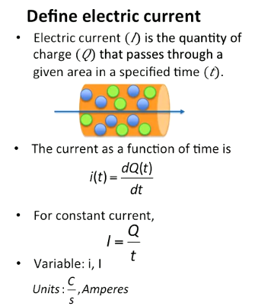
ELECTRIC CURRENT

Slide 7

Charge and Current
Mathematically,
$$I=\frac{dQ}{dt} or Q=\int_{t_{0}}^{t}{I.dt}$$
Or, in simple terms:
$$I=\frac{Q}{T}$$
So, 1 Ampere = 1 coulomb/ 1 second.

Slide 8
Quiz
1 mm of cross section of copper wire is isolated and 50 C of charge flows through it for 2 seconds. How much current will flow through wire?
50
100
25
0.04

Slide 9
QUIZ
1 mm of cross section of copper wire is isolated. The charge that flows in the cross section is
Q(t)= 4t² + 5, How much current will flow through wire in 6 seconds.
149 A
48 A
53
5A

Slide 10
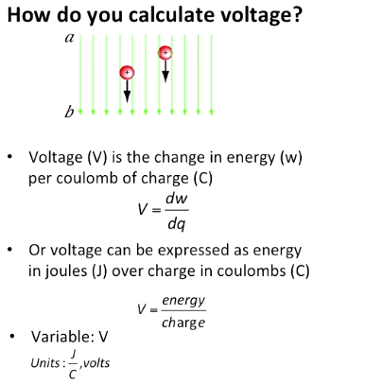
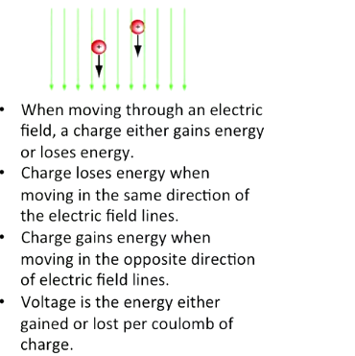
Voltage

Slide 11
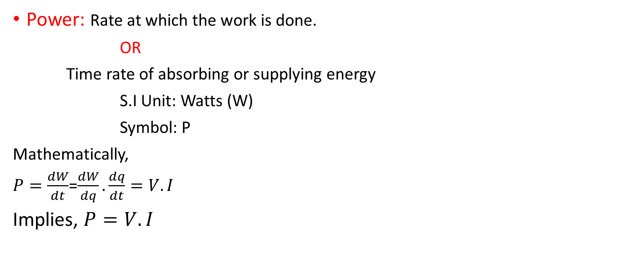
Power and Energy
Power: Rate at which the work is done.
OR
Time rate of absorbing or supplying energy
S.I Unit: Watts (W)
Symbol: P
Mathematically,
$P=\frac{dW}{dt}$=$\frac{dW}{dq}.\frac{dq}{dt}=V.I$
Implies, $P=V.I$

Slide 12
QUICK QUIZ (Poll )
1 Coulomb is same as:
Watt /sec
Ampere/sec
Joule-sec
Ampere-sec

Slide 13

QUICK QUIZ
The total charge entering the terminal is $5sin4πt mC.$ Calculate current at t= 0.5 sec.:
31.2 A
31.2 mA
62.8 mA
62.8 A

Slide 14
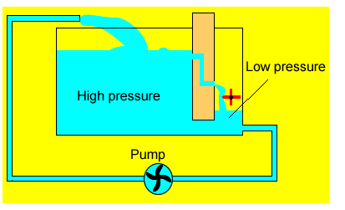
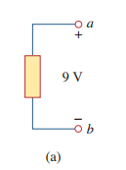


Voltage
It is the energy (Work) required to move a unit charge through an element.
S.I Unit: Volt (V)
Symbol: V
Notes:
Source: http://www.dynamicscience.com.au/tester/solutions1/electric/voltage.htm

Slide 15
Power and Energy
Energy: Capacity of doing work.
S.I Unit: Joules(J)
Symbol: E

Slide 16
QUICK QUIZ (Poll 3)
Calculate the current ratings of 100 Watt incandescent bulb and 15 Watt LED lamp operated with the domestic supply of 220 Volt?
Bulb = 0.068 A and LED = 0.45 A
Bulb = 0.45 A and LED = 0.068 A
Bulb =0.50 A and LED = 0.068 A
Bulb = 0.50 and LED = 0.68 A

Slide 17
Network Components
Active
Passive
Battery
Resistance (R)
Capacitance (C)
Inductance (L)
Transistor, Op-amp, etc

Slide 18
QUICK QUIZ (Poll 5)
Identify the passive element
Battery
Transformer
Transistor
OP-amp
None of these

Slide 19
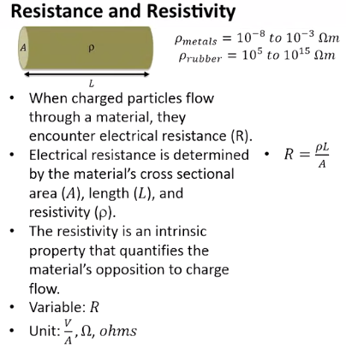
Resistance

Slide 20

Resistance
Resistance: It is an opposition to the flow of current.
S.I Unit: Ohm (Ω)
Symbol: R

Slide 21

Capacitance
Capacitance is the ability of a device to store electrical energy in an electrostatic field.
A capacitor is a device that stores energy in the form of an electrical field..
A capacitor is made of two conductors separated by a dielectric.
S.I Unit: Farad (F)
Symbol: C
Two important Properties:
No current flows through the capacitor, if the voltage remains constant.
Voltage across a capacitor cannot change instantaneously.

Slide 22
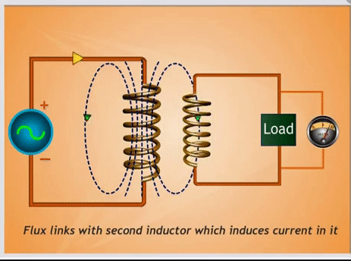
Inductance
Inductance is the characteristic of an electrical conductor that opposes a change in current flow.
An inductor is a device that stores energy in a magnetic field.
When a current flows through a conductor, magnetic field builds up around the conductor. This field contains energy and is the foundation for inductance
S.I Unit: Henry (H)
Symbol: L
Two important Properties:
No voltage appears across an inductor, if the current through it remains constant.
The current through an inductor cannot change instantaneously.
Notes:
Source: https://gfycat.com/directhauntinglamb

Slide 23
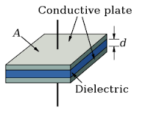
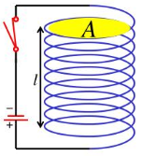


Capacitance and Inductance
$Q=CV$
$I=\frac{dQ}{dt}=\frac{d CV}{dt}=C\frac{dV}{dt}$
$E=\frac{1}{2}CV^{2}$
$C=\frac{A∈}{d}$
$V=L\frac{dI}{dt}$
$E=\frac{1}{2}LI^{2}$
$L=\frac{μN^{2}A}{L}$

Slide 24
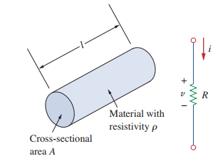
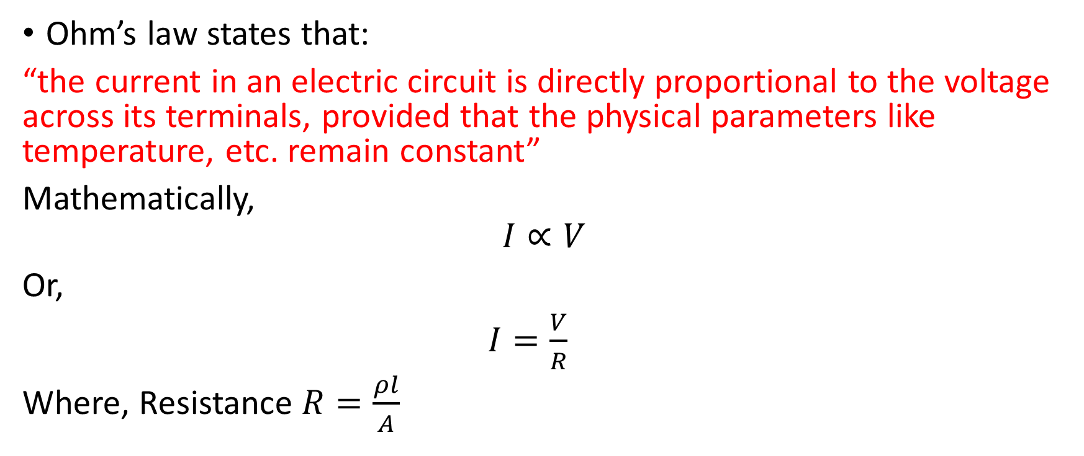
Ohm’s Law
Ohm’s law states that:
“the current in an electric circuit is directly proportional to the voltage across its terminals, provided that the physical parameters like temperature, etc. remain constant”
Mathematically,
$$I∝V$$
Or,
$I=\frac{V}{R}$
Where, Resistance $R=\frac{ρl}{A}$

Slide 25

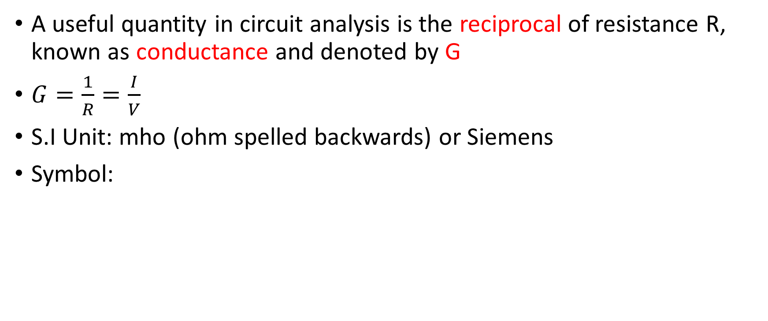
Conductance
A useful quantity in circuit analysis is the reciprocal of resistance R, known as conductance and denoted by G
$G=\frac{1}{R}=\frac{I}{V}$
S.I Unit: mho (ohm spelled backwards) or Siemens
Symbol:

Slide 26
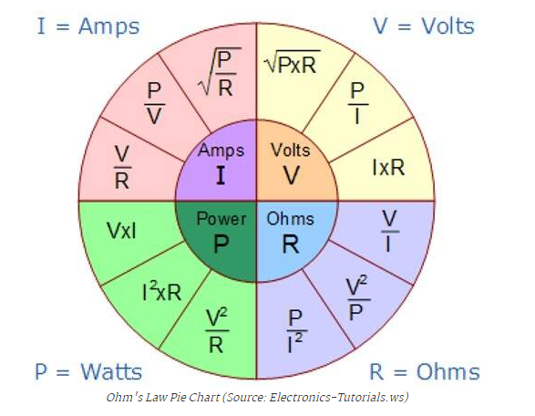
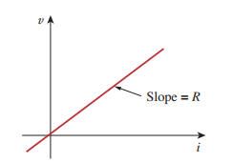

Interrelated terms
Power dissipated in the resistor can be expressed as:
$P=VI=I^{2}R=\frac{V^{2}}{R}$

Slide 27
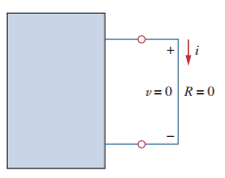
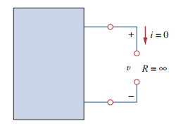

Short-circuit and Open-circuit
For a short circuit, R = 0 Ω
Therefore, V = I.R = 0 V
NOTE: (current, I can be of any value)
For an open circuit, R = $∞$ Ω
Therefore, I = V/R = 0 V
NOTE: (voltage,V can be of any value)

Slide 28
Consider a circuit with two unequal resistances in parallel, then a) large current flows in large resistor b) current is same in both c) potential difference across each is same d) smaller resistance has smaller conductance

Slide 29




Applications of Ohm’s Law
1. To find unknown Voltage (V)
2. To Find unknown Resistance (R)
3. To Find unknown Current (I)
4. Can be used to find Unknown Conductance (G)=1/R
5. Can be used to find unknown Power (P)=VI
6. Can be used to find unknown conductivity or Resistivity

Slide 30
Applications of Ohm’s Law
It is widely used in circuit analysis.
It is used in ammeter, multimeter, etc.
It is used to design resistors.
It is used to get the desired circuit drop in circuit design (Example, Domestic Fan Regulator).
Advanced laws such as Kirchhoff’s Norton’s law, Thevenin’s law are based on ohm’s law.
Electric heaters, kettles and other types of equipment working principle follow ohm’s law.
A laptop and mobile charger using DC power supply in operation and working principle of DC power supply depend on ohm’s law.

Slide 31
Limitations of Ohm’s Law
Ohm’s law holds true only for a conductor at a constant temperature. Resistivity changes with temperature.
Ohm’s law by itself is not sufficient to analyze circuits.
It is NOT applicable to non linear elements, For example, Diodes, Transistors, Thyristors, etc.

Slide 32
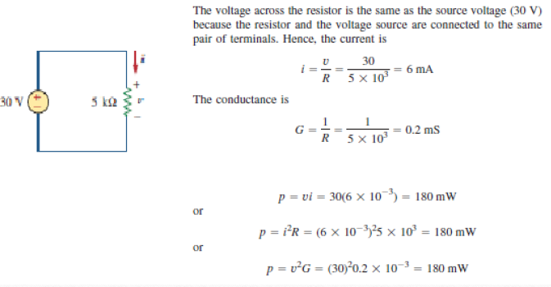
In the circuit shown in Fig., calculate the current i,
the conductance G, and the power p.
Solution:

Slide 33
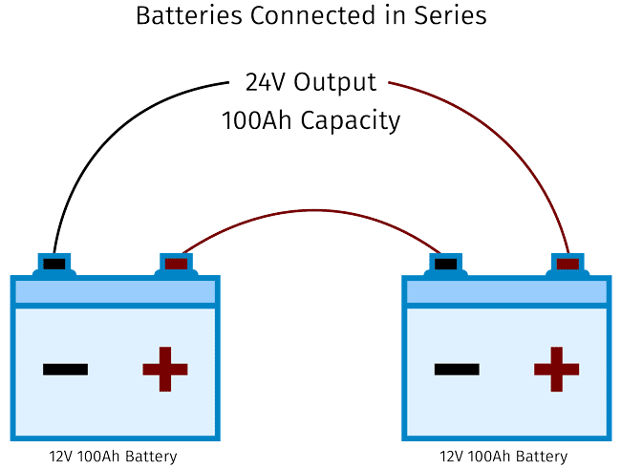
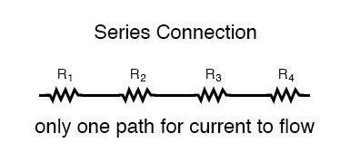
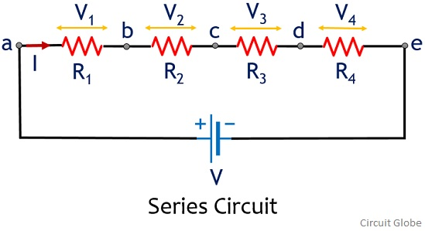
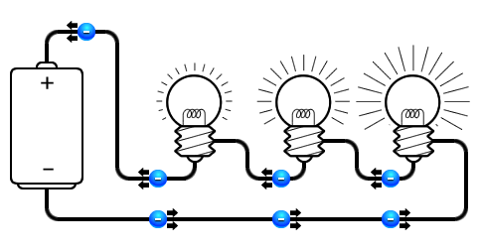
Series Connection
SERIES CONNECTION: Two or more elements are in series if they exclusively share a single node and consequently carry the same current.

Slide 34
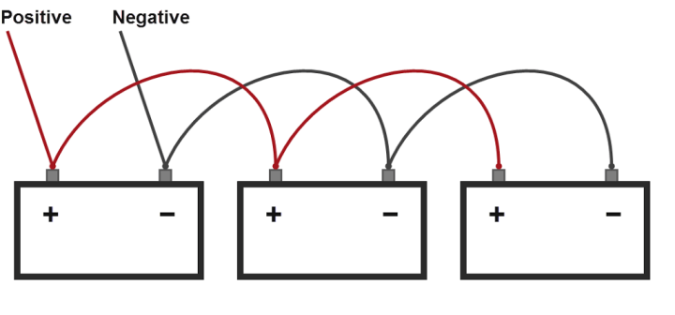
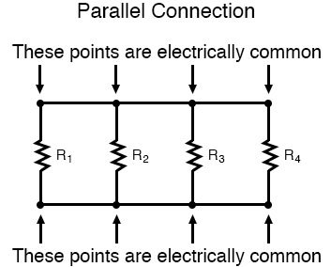
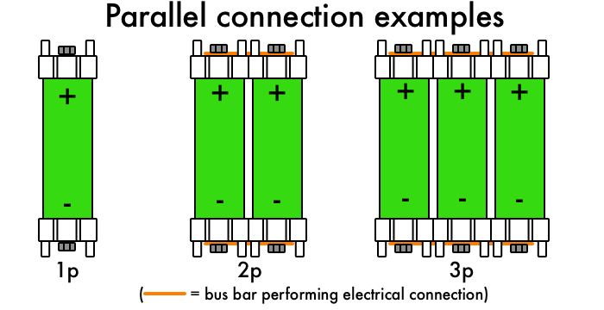
Parallel Connection
PARALLEL CONNECTION: Two or more elements are in parallel if they are connected to the same two nodes and consequently have the same voltage across them

Slide 35
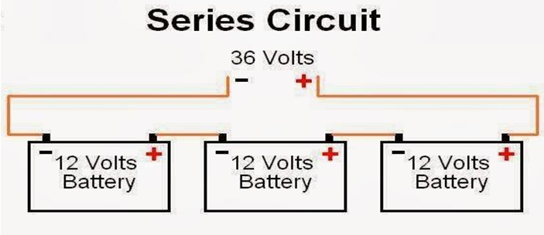
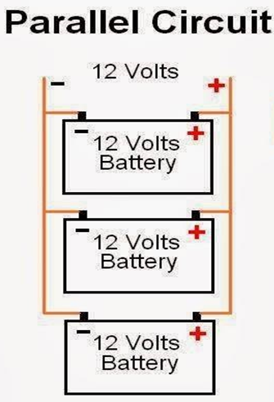
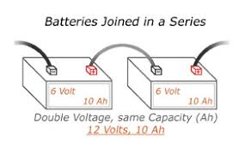
Battery Voltage In Series And Parallel

Slide 36
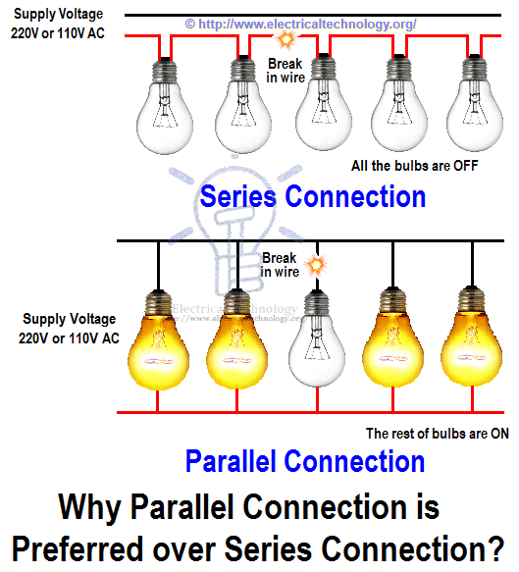
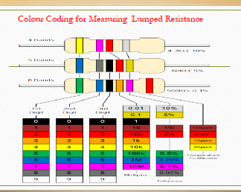

Slide 37
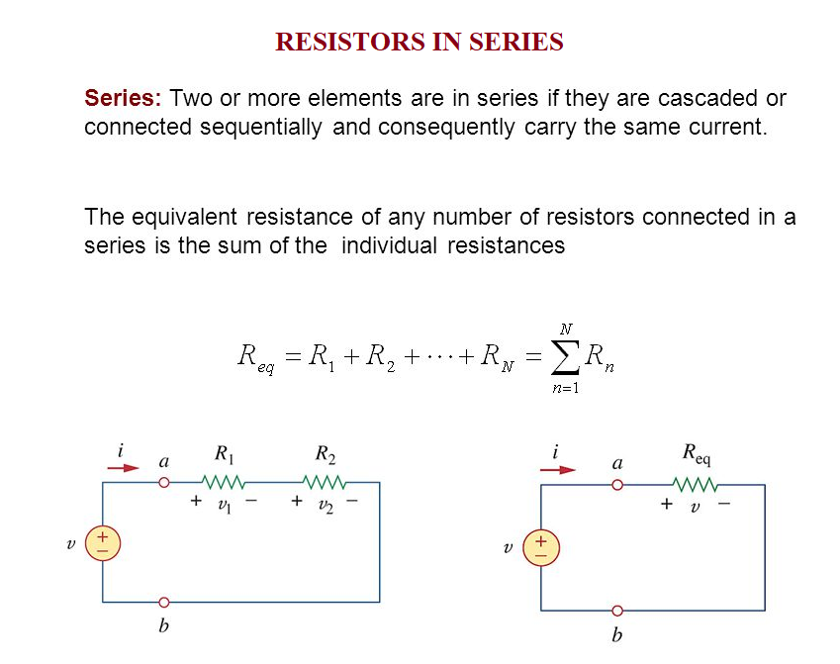
Note: Resistors in series behave as a single resistor whose resistance is equal to the sum of the resistances of the individual resistors.

Slide 38
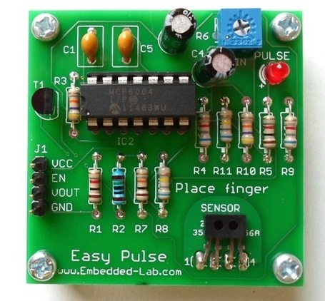
Printed Circuit Board

Slide 40
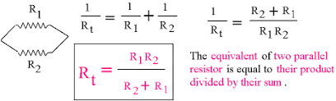
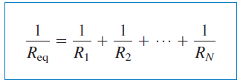
Resistors in Parallel .
https://www.falstad.com/circuit/e-resistors.html

Slide 41
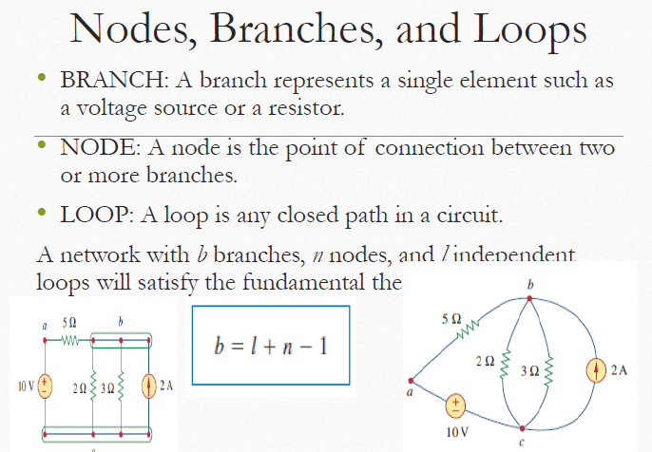

Slide 42
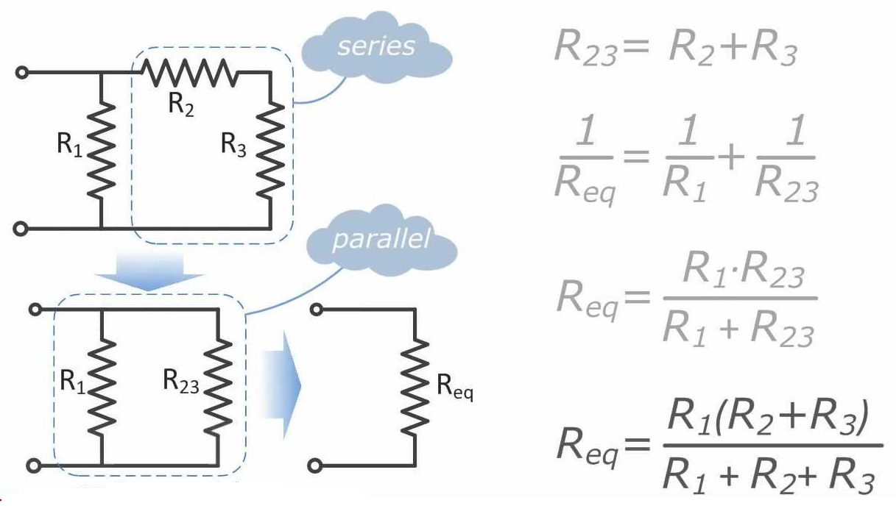
How to find Equivalent Resistance for Series-Parallel Combinations

Slide 43
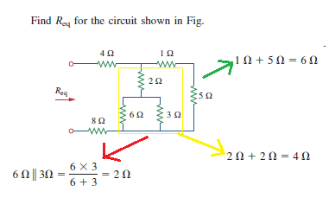
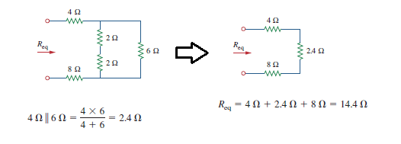

Example: To find${ R}_{eq}$

Slide 44
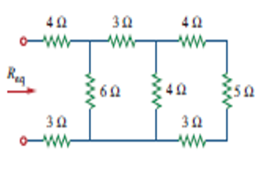
QUICK QUIZ (Poll)
Find Equivalent Resistance in Ohms?
5
10
15
20

Slide 45
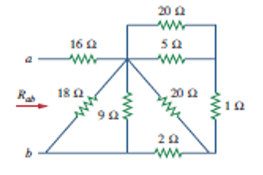
QUICK QUIZ (Poll)
Find Equivalent Resistance in Ohms?
12
17
19
29

Slide 46
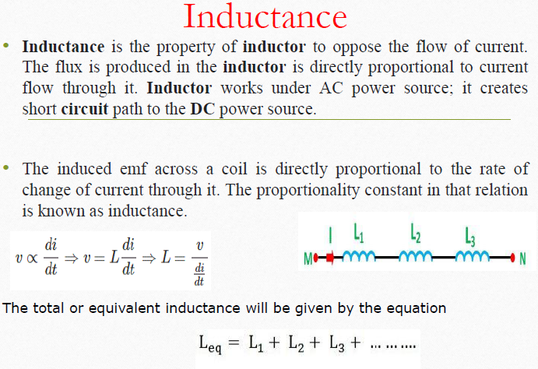

Slide 47


Slide 48


Slide 49


Slide 50
In series connection of resistors, what happens to the current across each resistor?
a) Increases b) Decreases c) Remain the same d) Initially increases and then decreases

Slide 51
R₁ = 1Ω, R₂ = 3Ω, R₃ = 5Ω and R₄ = 7Ω connected in series. Total voltage = 20V, Current I, V2 =? a) I = 1.23, V₂ = 3.75 b) I = 1.25, V₂ = 3.75 c) I = 1.15, V₂= 3.73 d) I = 1.16, V₂ = 3.72

Slide 52
If there are 9 nodes, then how many node-voltage equations are required? a) 9 b) 10 c) 8 d) 1

Slide 53
There are 13 branches in a complicated network and nearly 8 nodes. How many equations are required to solve the circuit in node-voltage method?
a) 7 b) 13 c) 5 d) 6

Slide 54
Useful Links
http://www.dynamicscience.com.au/tester/solutions1/electric/voltage.htm
https://gfycat.com/directhauntinglamb
https://www.youtube.com/watch?v=NfcgA1axPLo

